Slide 1
Telecommunication Churn Prediction
Objective:
To predict customer churn based on telecommunications data.
group members :
Omkar Sunil Bhoir
Aniket Rambhavan Yadav
Abhijeet Sudam Pawar
Tammu Jahnavi
Guguloth Supriya
Mohammed Abdul Uzair Ansari

Slide 2
INTRODUCTION
Churn prediction is one of the most popular big data use cases in business. It consists of detecting customers who are likely to cancel a subscription to a service.
Churn is a problem of telecom companies because it is more expensive to acquire a new customer than to keep your existing one from leaving.
Customer churn is a key issue for telecommunication companies.
Predicting churn can help in reducing customer loss by implementing retention strategies.

Slide 3
OBJECTIVE
To predict customer churn.
Highlighting the main factors influencing customer churn.
Use various ML and deep learning algorithms to build predicting model , evaluate the accuracy and performance of the model.
Finding out the best model for the business case.

Slide 4
Dataset Overview
The dataset contains customer-related data such as:
Total minutes (day, evening, night, international)
Number of calls (day, evening, night, international)
Customer service calls
Charges
Churn status (yes/no)

Slide 5
Data Preprocessing
Missing values were handled by filing.
Features like total_day_minutes, total_eve_minutes, and customer_service_calls were key indicators of customer activity.
The dataset wasn’t balanced with yes and no churn labels. So, this handled by some techniques like SMOTE, RandomUnderSampler and RandomOverSampler.
Scaling (StandardScaler)
PCA

Slide 6
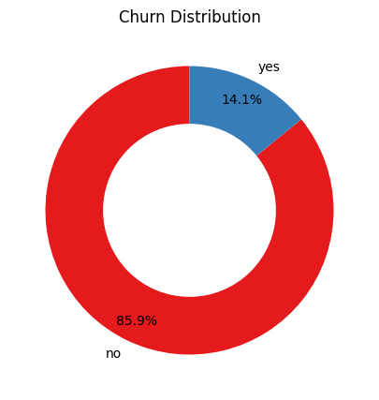
Exploratory Data Analysis (EDA)
Churn Rate:
Visualization of churn distribution among customers.
Key statistics on churned vs. non-churned users.

Slide 7
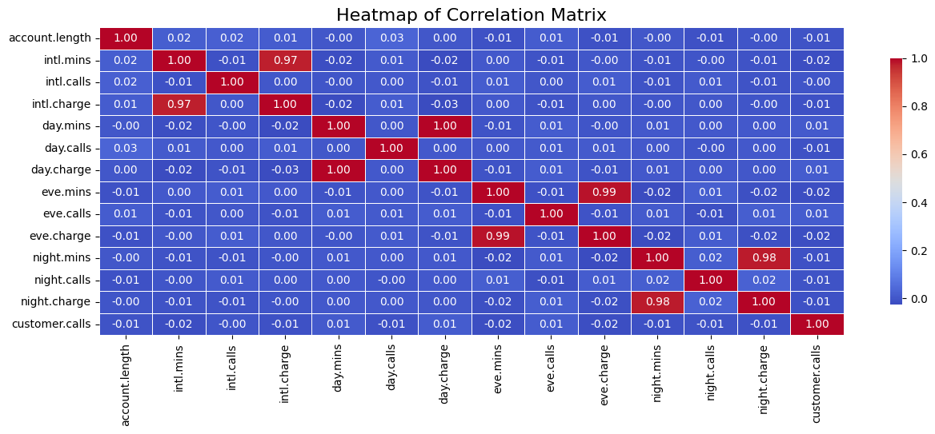
Feature Correlation:
Identification of highly correlated features impacting churn.
Heatmap displaying relationships among features.

Slide 8
Model Building
Logistic Regression: A basic classification model to predict churn.
Random Forest Classifier: Used for better accuracy by leveraging multiple decision trees.
ANN (LSTM) : Used for better accuracy .
Evaluation Metrics:
Accuracy, Precision, Recall, F1-Score, and ROC-AUC were used to assess the model's performance.

Slide 9
Results
Confusion Matrix: Displaying true positives, true negatives, false positives, and false negatives.
Model Accuracy: Achieved approximately 92% accuracy in predicting churn.
Model Comparison:
Logistic Regression vs. Random Forest vs. LSTM:
LSTM model outperformed both the Logistic Regression and Random Forest with a higher accuracy and recall rate for churn detection.

Slide 10
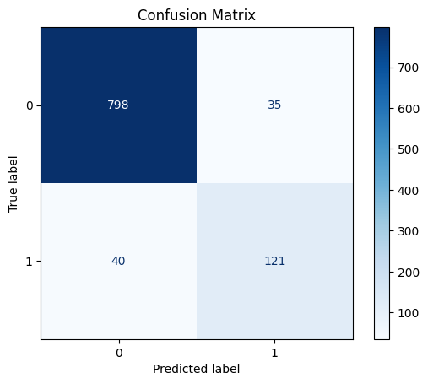

Slide 11
Conclusion
Predictive models can significantly help in identifying churn-prone customers.
Implementing proactive retention strategies can reduce customer churn and improve revenue.

Slide 12
Thank You

